Slide 1

Superstore Sales
Insights Derived from Dashboard

Slide 2
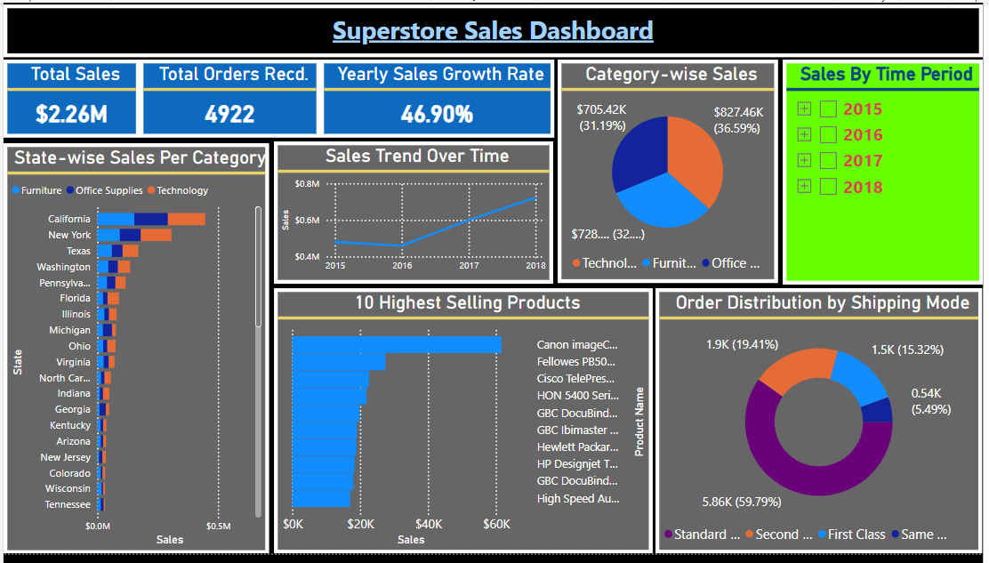

Slide 3

Total Sales: $2.26 Million in Revenue.
Total Orders: 4922 Orders Recd.
Yearly Sales Growth: 46.90% Increase.
Insights:
Sales are growing rapidly, showing strong customer demand. Focus on maintaining growth by improving marketing, inventory, and customer service.

Slide 4
Top Selling States: California, New York, Texas lead in sales.
Sales by Category: Furniture, Office Supplies, Technology are strong across top states.
Insights:
Focus marketing efforts on states with low sales. Analyze top-performing states and apply those strategies elsewhere.

Slide 5
Category-Wise Sales Distribution:
🛋️ Furniture: $827K (36.59%)
📒 Office Supplies: $728K (32.22%)
🖥️ Technology: $705K (31.19%)
Insights:
Furniture is the highest-selling category. Invest in furniture inventory and promotions. Identify improvement areas for other categories.

Slide 6
Sales Trend Over Time:
Sales are steadily increasing from 2015 to 2018.
Insights:
The business is growing consistently. Maintain current strategies and explore new opportunities to keep the momentum going.

Slide 7
Best-selling Products:
Canon printers, HP Designjet, Fellowes binders, Cisco telepresence systems, etc.
Insights:
Focus on the high-demand products. Ensure sufficient stock and promote them to boost sales.

Slide 8
Order Distribution by Shipping Mode:
🚚 Standard Shipping: 5.86K orders (59.79%)
✈️ Second Shipping: 1.9K orders (19.41%)
🚀 First-Class Shipping: 1.5K orders (15.32%)
⚡ Same-Day Shipping: 0.54K orders (5.49%)
Insights:
Standard shipping is the most preferred. Optimize logistics for efficiency. Promote faster shipping for urgent orders to increase customer satisfaction.

Slide 9
Overall Recommendations for Business Growth:
Strengthen sales in low-performing states.
Invest in top-selling products for maximum profit.
Maintain positive sales trends with smart inventory planning.
Improve logistics for better customer service.

